Slide 1
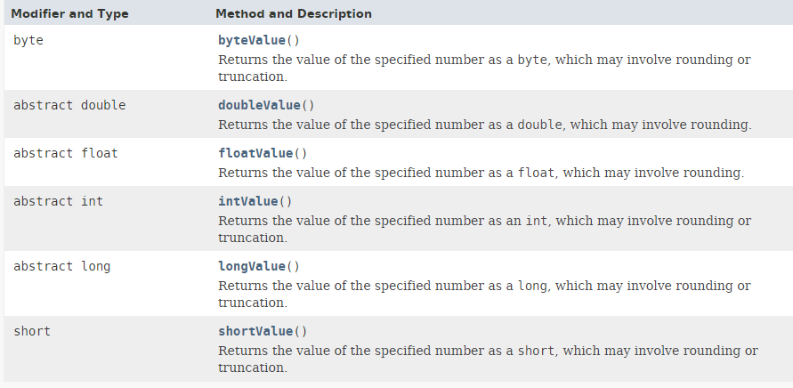
Wrapper Class
Below are the methods that all the subclasses(e.g. Integer, Long etc.) of the Number class implement.
Converts the value of this Number object to the primitive data type returned.

